Slide 1
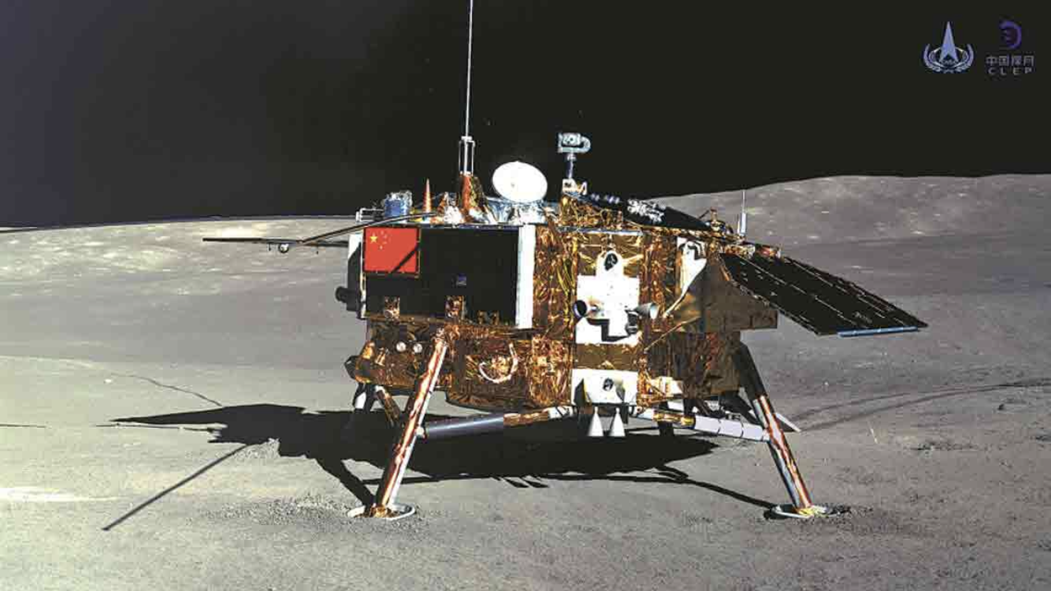
Next Chinese moon launch
.

Slide 2
Words
probe [proʊb] adj.检验的(鉴定的.证明的.提供证据的)
deputy['dɛpjuti] n.代表.副手.议员
administration [əd,mɪnɪ'streʃən] n.实施.管理.行政.行政部门.任期
mission['mɪʃən] n. 代表团.使命.官方使命
v. 给…交代任务.派遣.把任务交给.向…传教
phase[fez] n.相位.方面.局面.阶段.时期
vt.逐步执行
retrieve [rɪ'triv] vt. 检索.恢复.重新得到
vi. 找回猎物 n. 检索.恢复,取回
pole [pol] n. 杆.极点.电极 vt. 用竿支撑
verify ['vɛrɪfaɪ] vt.核实.证明
expedition[,ɛkspə'dɪʃən] n.远征.探险队.迅速

Slide 3
Question
1.What's the purpose of Chang 'e-5 Launch?
2.What's the point of the operation?

Slide 4
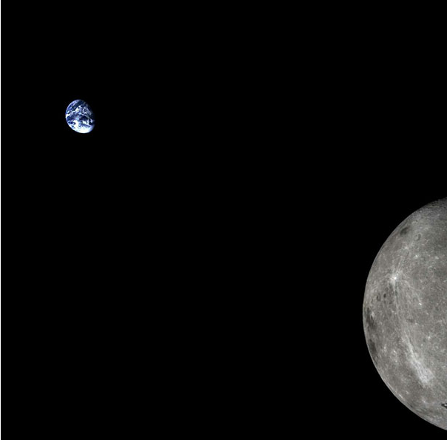
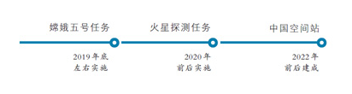

Chang’e 5
$TOP→_→$ China plans to send its Chang'e 5 probe to the moon around the end of the year and bring lunar samples back to Earth.

Slide 5

Primary Coverage
Wu Yanhua, deputy head of the China National Space Administration(国家航天局副局长吴艳华), said Jan. 14th afternoon that the Chang’e 5 mission will be the next step in China's lunar exploration and will mark the completion of the program's third phase, whose goal is guiding a probe carrying lunar soil back to Earth.
If Chang’e 5 succeeds in its mission, China will become the third nation to retrieve lunar samples, after the US and Russia.

Slide 6
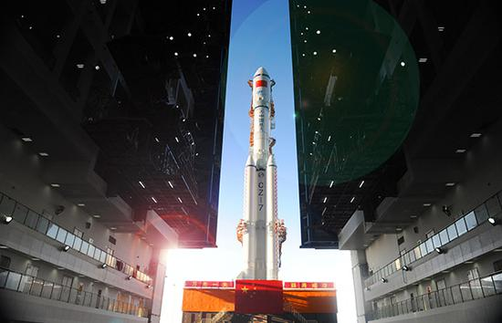
After Chang’e 5
After Chang'e 5, China has plans for Chang'e 6, 7 and 8 missions, Wu said.
Chang'e 6 is intended to land on the moon's south pole, he said, and return with rocks and soil.
Chang'e 7 will investigate the south pole, and Chang'e 8 will be tasked with verifying advanced technologies that may be applied in future lunar expeditions.

Slide 7
Question
1.What's the purpose of Chang 'e-5 Launch?
To bring lunar samples back to earth.
2.What's the point of the operation?
Technological innovation.
Gather experience.
Priming of economy.
Get images.(获取图像)

Slide 8
My own opinion
China's space industry has taken another big step forward and formed an alternative shock to the outside world.
China's international status will be elevated.
It is conducive to enhancing the pride of the Chinese people.

Slide 9
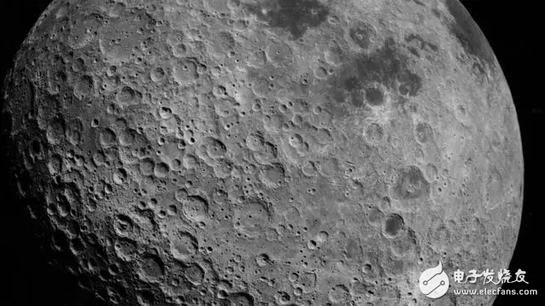
THX:P

